Slide 1
Python Function
Session 5

Slide 2
Objectives
Functions in Python
Functions argument

Slide 3
Python - Functions
A function is a block of organized, reusable code that is used to perform a single, related action. Functions provide better modularity for your application and a high degree of code reusing.
Python functions types:
  Built-in functions like print()
  User-defined functions.
Functions are the most important aspect of an application. A function can be defined as the organized block of reusable code which can be called whenever required.
Python allows us to divide a large program into the basic building blocks known as function. The function contains the set of programming statements enclosed by {}. A function can be called multiple times to provide reusability and modularity to the python program.
In other words, we can say that the collection of functions creates a program. The function is also known as procedure or subroutine in other programming languages.

Slide 4
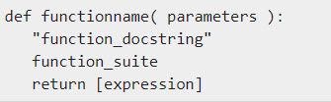

Python - Functions
Syntax
By default, parameters have a positional behavior and you need to inform them in the same order that they were defined.
Example

Slide 5
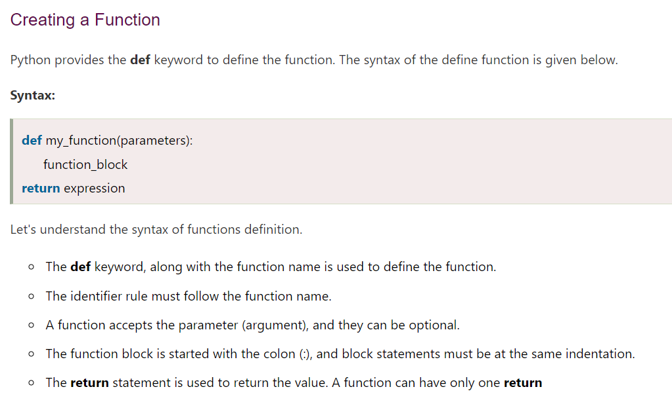
Python - Functions

Slide 6
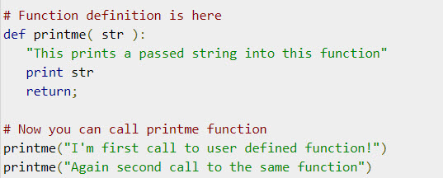

Calling a Function
Defining a function only gives it a name, specifies the parameters that are to be included in the function and structures the blocks of code.
Once the basic structure of a function is finalized, you can execute it by calling it from another function or directly from the Python prompt. Following is the example to call printme() function −
Example
Output

Slide 7
Function Arguments
You can call a function by using the following types of formal arguments
  Required arguments
  Keyword arguments
  Default arguments
  Variable-length arguments

Slide 8
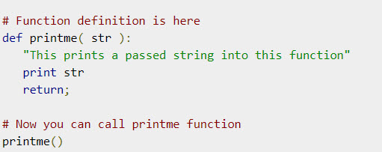
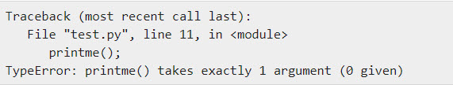
Required arguments
Required arguments are the arguments passed to a function in correct positional order. Here, the number of arguments in the function call should match exactly with the function definition.
To call the function printme(), you definitely need to pass one argument, otherwise it gives a syntax error as follows −
Output

Slide 9
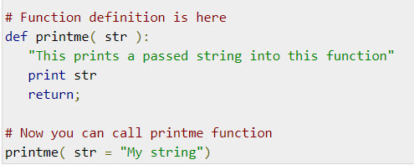

Keyword arguments
Keyword arguments are related to the function calls. When you use keyword arguments in a function call, the caller identifies the arguments by the parameter name.
This allows you to skip arguments or place them out of order because the Python interpreter is able to use the keywords provided to match the values with parameters. You can also make keyword calls to the printme() function in the following ways −
Output

Slide 10
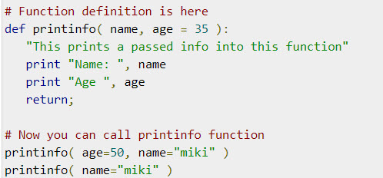
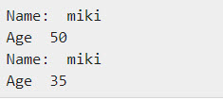
Default arguments
A default argument is an argument that assumes a default value if a value is not provided in the function call for that argument. The following example gives an idea on default arguments, it prints default age if it is not passed −
Output

Slide 11
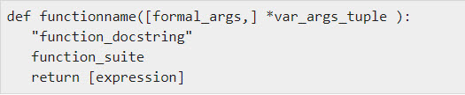
Variable-length arguments
You may need to process a function for more arguments than you specified while defining the function. These arguments are called variable-length arguments and are not named in the function definition, unlike required and default arguments.
Syntax for a function with non-keyword variable arguments is this −
An asterisk (*) is placed before the variable name that holds the values of all nonkeyword variable arguments. This tuple remains empty if no additional arguments are specified during the function call.

Slide 12
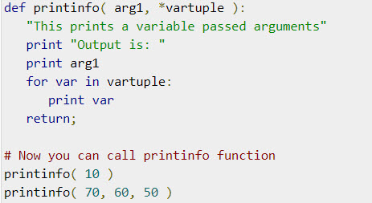
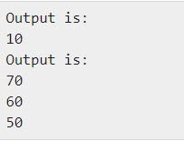
Variable-length arguments
Example
Output

Slide 13
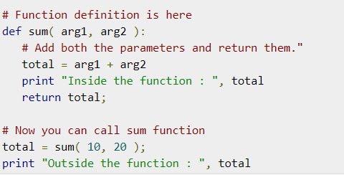

The return Statement
The statement return [expression] exits a function, optionally passing back an expression to the caller. A return statement with no arguments is the same as return None.
All the above examples are not returning any value. You can return a value from a function as follows −
Output

Slide 14
Summary
Functions in Python
Functions argument

